Slide 1
Clean Energy Partnership Board
Q1 Meeting
March 4, 2016

Slide 2
Agenda
10:00 – Welcome & Introductions
10:05 - Approval of Minutes and Agenda Review
10:10 – Update on Recent Partnership Activities
10:30 – Multi-Family Building Efficiency Program Update
10:40 - EVAC Community Engagement Process
11:30 - Announcements

Slide 3
Update on Recent Partnership Activities
Annual report preparations
City residential energy efficiency policy research
Community Solar Gardens update
HES buy-down and 0% financing
Commercial Benchmarking
Benchmarking Tool - Washington D.C. visit

Slide 4
2015-2016 Approved Metrics
1 | Citywide GHG emissions
1.1 | GHG emissions from electricity use
1.2 | GHG emissions from natural gas use
2 | Commercial building energy use
2.1 | Commercial buildng benchmarking results
2.2 | Commerical utility EE program utilization
3 | Residential building energy use
4 | Local or directly purchase renewable energy
4.1 | Windsource customers
4.2 | Community solar garden subscribers
4.3 | Rooftop solar
5 | Home Energy Squad visits
5.1 | Percent of eligible properties served by HES
5.2 | HES-driven loans
6 | Low-income visits
7 | Air sealing/insulation (ASI)
8 | Multi-family program participation
8.1 | Percent of eligible MF properties served by MFBE
8.2 | Percent of properties participating in MFBE that engaged in activity beyond audit & direct install (conversion rate)
4
Notes:
As a reminder, you approved the metrics for our first two year work plan at the Q4 meeting in November. They are as you see here.

Slide 5
Annual Report Preparation
Metrics Gathering
Each organization is compiling data; Minneapolis, CenterPoint Energy & Xcel Energy
Annual Report Structure
Will begin with a “scorecard” including raw 2015 numbers for all of the approved metrics
Then delve into each of the metrics, providing context and, where available, historical data.
Will provide 2014 numbers for baseline
Next steps
Q2 – Planning team will present draft to EVAC for feedback, using that feedback, a final version will be presented to the Board at their Q2 meeting
Report will be presented to City Council
5
Notes:
Gayle will include information for this slide

Slide 6
City Residential Energy Efficiency Policy Research
Reviewing four potential policy options:
Energy audit requirement for rental license
Energy disclosure through Truth in Sale of Housing
Expanding Commercial Building Energy Benchmarking to include Multifamily
Sustainable Building Policy (new construction or rehab with City financing)
Review with City departments
City Council direction
External Stakeholder engagement
Q1 2016
Q2 2016
Q2 2016?
6

Slide 7
City of Minneapolis - Community Solar Garden Update
City Council authorized Community Solar Garden agreements with 4 suppliers totaling 7.5 million kWh annually via the Met Council RFP.
City developing Request for Proposals (RFP) community solar garden services for City facilities, that will include low income participation and other attributes.
Saturday April 2 Community Solar Garden Speed Dating Event (as part of Minneapolis Community Connections Conference at Convention Center)
7
Notes:
Gayle will include information for this slide

Slide 8
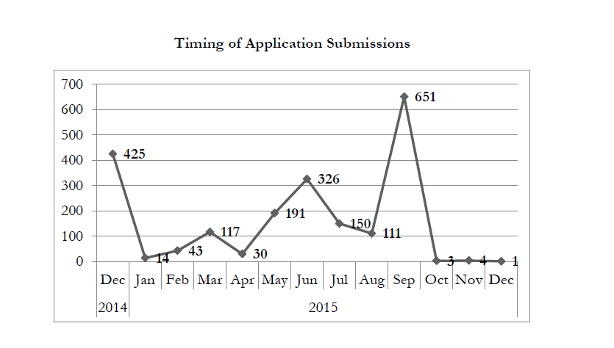
Minnesota Solar*RewardsSM CommunitySM Status Report | February 26, 2016
SUBMITTED APPLICATIONS TO DATE
>25 developers have submitted applications
No new applications since December 2015
Interconnection Queue Summary
 | Applications | MW | Project Sites
Applications in Interconnection Process | 801 | 754 | 180
Process Details
Study SOW Not Issued by Xcel Eenrgy | - | - | -
Study SOW Issued by Xcel Energy | 801 | 754 | 180
a. SOW Waiting for Developer | 91 | 78 | 21
b. Studies in Process* | 602 | 569 | 132
c. Completed Studies | 108 | 107 | 27
Entering Design/Construction | 111 | 107 | 33
ACTIVE APPLICATIONS
9% pending completeness
60% applications currently being studied
11% in Design and Construction
* Includes projects “Expedited Ready”
PROGRAM UPDATE
Some Expedited Ready studies will be delivered ahead of the mid-March deadline; all are progressing to meet the deadline.
The earliest gardens are close to completing detailed design and entering into interconnection construction.
Xcel Energy continues to clarify roles and use of the Xcel Energy brand with external parties, as calls from concerned customers, communities and media contacts increase
Xcel Energy has begun notifying impacted solar gardens when substation capacity is reached.
INTERCONNECTION QUEUE
180 projects currently in the interconnection process
33 projects entering Design and Construction
8

Slide 9
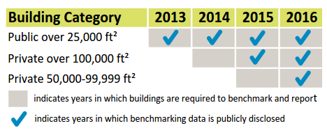
Commercial Energy Disclosure Benchmarking Report
Total Buildings Analyzed
429
% of City’s Total Commercial Area
50%
Median ENERGY STAR Score
74
Response Rate
90+%
9

Slide 10
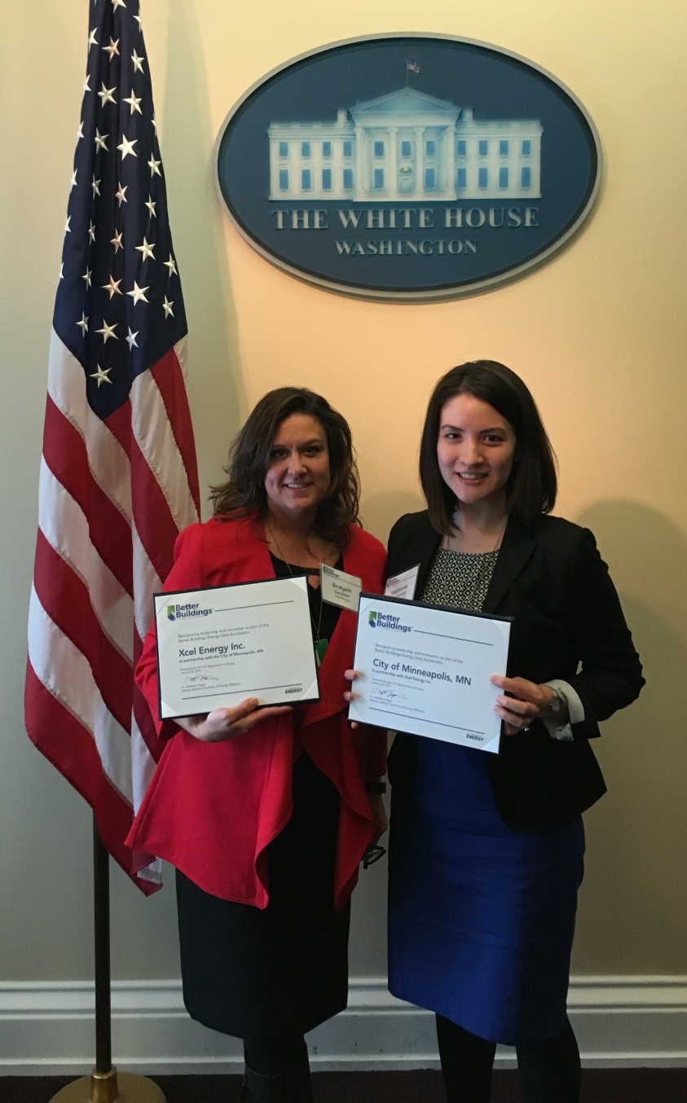
DOE Better Buildings Recognition
City of Minneapolis and Xcel Energy recognized for completing two-year data accelerator.
Tool makes whole-building energy data more accessible to building managers
Compliments City’s benchmarking ordinance
Discussion featured innovative city-utility partnerships

Slide 11
Multi-Family Building Efficiency Program
Participation October 2015-Mid February 2016
Stage | Minneapolis | Other Cities | Total
Inquiries | 33 (2,420)* | 83 (5,614) | 116 (8,034)
Qualified | 30 (2,179) | 70 (4,923) | 100 (7,102)
Pending | 23 (1,940) | 47 (3,609) | 70 (5,549)
Scheduled | 1 (67) | 2 (91) | 3 (158)
DI/Audit Visit | 6 (172) | 18 (1,078) | 24 (1,250)
Report |  | 3 (145) | 3 (145)
Implementation
*Buildings(Units)

Slide 12
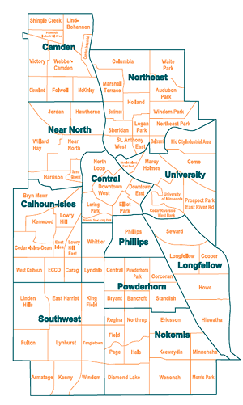
Multi-Family Building Efficiency Program
Qualified Buildings
3
7
6
14

Slide 13
Multi-Family Building Efficiency Program
Low Income Participation
October 2015-Mid February 2016
(Subset of Previous Table)
Stage | Minneapolis | Other Cities | Total
Inquiries | 7 (877)* | 17 (1,867) | 24 (2,744)
Qualified | 6 (790) | 15 (1,774) | 21 (2,564)
Pending | 5 (760) | 10 (1,036) | 15 (1,796)
Scheduled |  | 2 (91) | 2 (91)
DI/Audit Visit | 1 (30) | 3 (647) | 4 (677)
Report
Implementation
*Buildings(Units)

Slide 14
EVAC Community Engagement Task Force Proposed Engagement Plan Matt Kazinka & Annie Levenson-Falk March 4, 2016

Slide 15
Clean Energy Partnership Goals
By 2025:
75% participation in efficiency retrofit programs in residential properties (both rental and owner-occupied), with equitable distribution
15% energy efficiency in residential buildings; 20% in commercial/industrial buildings
10% local or directly purchased renewable energy
Notes:
Assumptions:
Current program participants skews white, middle/upper-class, homeowners
Engagement focus on people who are not being reached as well now

Slide 16
Marketing & Outreach
Community Engagement
Notes:
We will never reach 75% goal by doing more of what we do today. Need a different approach, but we don’t yet know what that is
Purpose of engagement is to reach residents and also to learn
Engagement is a two-way street
Tension between linear and complex approaches (true to the real situation) and limit to our capacity/resources.
Not tactics-oriented and not quick approaches. Need to learn before we jump in.
At the same time, need to start accomplishing things with the time and resources that are available to us.
Our plan attempts to find the right balance within that tension

Slide 17
Proposed engagement plan
Decisions made by the committee:
City consists of people in communities
No one approach will be effective across all communities
Need a template to guide engagement in any community in Minneapolis
Need to develop plans for each community with input from community leaders
Notes:
The template should work in any community from small businesses downtown to Latino renters on the southside

Slide 18
Proposed engagement plan
Proposal for 2016 and 2017:
Pilot community-specific engagement activities in 2-4 communities
Test out template process for developing community-specific engagement strategies
Focus on communities that are currently not being engaged successfully
Notes:
Walk through the plan here

Slide 19
Proposed engagement plan
Engagement process template:
5 key steps:
Prepare
Learn
Design Plan
Implement Plan
Evaluate
Can be replicated in any community
Notes:
Walk through the plan here

Slide 20
Proposed engagement plan
Priorities for pilot communities
EVAC will propose 2-4 communities by Q2 based on data analysis
Priorities for selecting pilots:
Learn how to do community engagement better
Have an impact on energy savings for communities with high potential to benefit
Choosing different communities with different needs to maximize our opportunity to learn
Notes:
Walk through the plan here

Slide 21
Proposed engagement plan
Who should conduct the pilot?
RFP process to select contractor
Low draw on existing staff resources
Ability to tap subject experts and people already embedded in priority communities
Funding-dependent
Notes:
Walk through the plan here

Slide 22
Proposed next steps
2016 Q2
2016 Q3
2016 Q4 – 2017 Q1
2017 Q2 – 2017 Q3
Select pilot communities
Seek funding for RFP
Release RFP
Secure contractor
Contractor develops plans
CEP Board approves plans
Contractor implements plan
Lessons captured and shared
Notes:
RFP would fund partners to develop and carry out targeted community engagement plans, plus technical assistance that will be needed
CEP makes the final decision on all this
To be done by combination of staff and EVAC members
Q2-Q4 tasks not presumed to be same task force membership
Ask who wants to participate

Slide 23
Announcements
Next Clean Energy Partnership Board Meeting
June 3, 2016
10am -12pm

